Slide 1
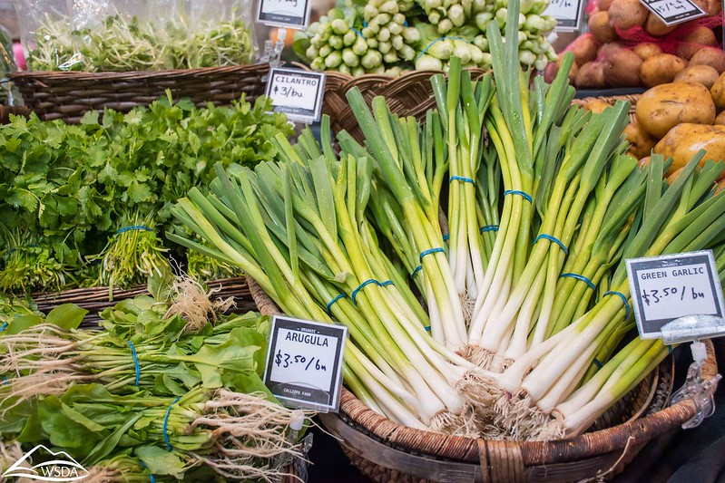
We Feed Washington ends June 30, 2025
In 2021, WSDA was directed by the Washington State legislature to develop a state alternative to the federal COVID-19 relief program, the USDA Farmers to Families Food Box program. State and federal emergency declarations ended in 2022 and 2023, respectively, and as a result, WSDA’s remaining COVID-19 relief
programs including the We Feed Washington grant program will end on June 30, 2025.
Recognizing a need for sustained enhanced Food Assistance investments, WSDA leadership seeks to transition all ongoing support for hunger relief organizations and the emergency food system back to our statutory Food Assistance programs beginning in July 2025.
For the 2025-2027 biennium, WSDA has submitted a historic budget request to the Governor for Food Assistance programs, and with additional funding, will be able to make a larger investment in Food Assistance Resiliency Grants which may be a future funding avenue for current We Feed WA grantees and supported projects.

Slide 2
2025 WSDA Food & Equity Budget Requests
Sustained Enhanced Food Assistance $93.25M
Agricultural Climate Resilience Research $6.1M
Small Meat & Poultry Assistance & Grant $4.5M
Growing Diverse Leaders $2.4M
Local Food System Infrastructure Grant $2M
Climate Livestock Composting $1.7M
WA Promotion & Labeling Program $1.3M
Organic Inspection Credit $1.3M
Equity & Environmental Justice, Ag Mental Health and Services for Underrepresented Farmers & Ranchers staff $2.4M (combined)

Slide 3

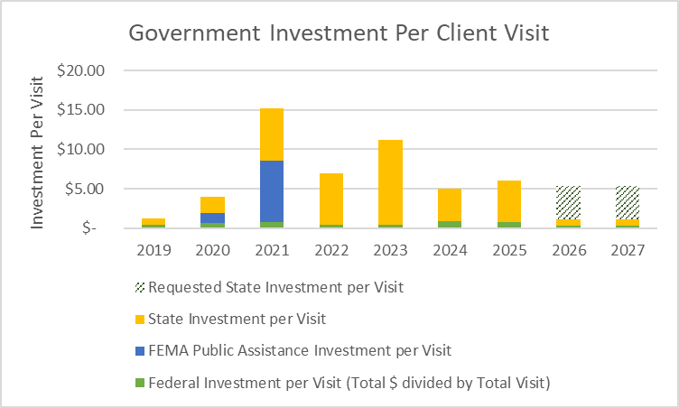
WSDA’s 2025 Food Assistance Budget Request
Notes:
The demand for food assistance in all forms has outstripped the available funding throughout WSDA’s coordinated response to COVID-19 food security. The amount of resources necessary to adequately or comprehensively resource community-based hunger relief organizations is unknown. In response, this request represents WSDA’s largest ever request for ongoing Food Assistance funding.
If funded, based on a conservative estimate of sustained client visits in 2024 and beyond, this request would bring the state investment per client visit up to $5. The state average in 2019 was $.78 per visit, while the maximum was $10.76 per visit in 2023.

Slide 4

Future
Permanently increase EFAP and EFAP-tribal passthrough funding.
Continue to offer annual grants to any hunger relief program, regardless of their historic participation in Food Assistance programs or not.
Increase passthrough funding for the state share of TEFAP and federal program operating expenses.
WSDA will continue to invest in 3 core strategies to meet the needs of the hunger-relief community
Notes:
WSDA will continue to invest in 3 core strategies to meet the needs of the hunger-relief community:
1. Permanently increase EFAP and EFAP-Tribal passthrough funding.
2. Continue to offer annual grants to any hunger relief program, regardless of their historic participation in Food Assistance programs or not.
3. Increase passthrough funding for the state share of TEFAP and federal program operating expenses.

Slide 5
State Funding Levels: Current & Projected Pass-through
State Estimate - Includes CSLFRF | 2024 | 2025 | 2026 | 2027
EFAP State | $ 4,890,725.00 | $ 4,890,725.00 | $ - | $ -
EFAP State Supplemental & New 2026 | $ 4,491,357.37 | $ 4,275,062.90 | $ 24,300,000.00 | $ 24,300,000.00
EFAP Federal | $ 3,405,062.50 | $ 3,405,062.50 | $ - | $ -
EFAP - Tribal State | $ 513,391.00 | $ 513,391.00 | $ - | $ -
EFAP - Tribal State Supplemental & New 2026 | $ 499,039.87 | $ 475,006.85 | $ 2,700,000.00 | $ 2,700,000.00
EFAP - Tribal Federal | $ 357,437.50 | $ 357,437.50 | $ - | $ -
Resiliency Grants State | $ - | $ 5,300,000.00 | $ 16,000,000.00 | $ 16,000,000.00
Resiliency Grants Federal | $ 5,305,000.00 | $ - | $ - | $ -
Farm 2 Food Pantry | $ 649,999.94 | $ 650,000.00 | $ 1,000,000.00 | $ 1,000,000.00
Misc. Grants (WFC, CH, etc.) | $ 680,346.90 | $ 869,324.75 | $ 305,000.00 | $ 305,000.00
Misc. Flexible New 2026 |  |  | $ 500,000.00 | $ 500,000.00
LFPA GAP | $ 120,000.00 | $ 120,000.00 | $ 200,000.00 | $ -
CSFP GAP - State | $ - | $ 235,000.00 | $ 800,000.00 | $ 800,000.00
CSFP GAP - Federal | $ 200,000.00 | $ - | $ - | $ -
TEFAP GAP - State | $ - | $ 520,000.00 | $ 3,000,000.00 | $ 3,000,000.00
TEFAP GAP-Federal | $ 2,492,526.60 | $ 1,880,000.00 | $ - | $ -
FA Direct Food Purchase | $ 6,971,894.35 | $ 4,205,000.00 | $ - | $ -
Total State - Includes CSLFRF | $ 30,576,781.03 | $ 27,696,010.50 | $ 48,805,000.00 | $ 48,605,000.00
Notes:
Here is a snapshot of this biennium compared with the proposed new STATE funding is highlighted in green – shows only state pass-through funding levels. Assumes full funding of proposed legislative budget request and assumes it is on-going. Different approach with some of our ongoing funding versus what would be funded out of the new projected funds – shifts funding categories and simplifies funding sources. Please note that WSDA FA does not plan to continue with conducting FA direct food purchases (reserve warehouse foods) in SFY 26 and 27.
Reminder that this does not include “regular” federal funds or food (TEFAP, CSFP, TEFAP R&R, TEFAP FTFB, LFPA etc.) but as you can see in SFY 26 and 27:
EFAP- Almost double
Current 12.5 million
Proposes 24 million
EFAP Tribal
Current 1.34 million
Proposed 2.7 million
Resiliency Grants – Nearly Triples
Current 5.3 million
Proposed 16 million
GAP funding
TEFAP 2.4 to 3 million (Fed gov. does not provide enough money. Fed budget is always delayed 6+ months)
CSFP 235k to 800k (most expensive program to run – Administrative burden)
Farm to Food Pantry
650k to 1 million
MISC – TBD
Simplify Language with legislators.

Slide 6

Funding Summary
Doubles EFAP and EFAP-Tribal
Triples Resiliency Grants
Note: A substantial investment in Food Assistance grants will increase Resiliency grant funding levels as well as absorb some of the demand for the We Feed WA COVID-19 relief program.
Increases TEFAP/CSFP GAP Funding
Increases Farm to Food Pantry from $650K to $ 1M per year
Keep in mind that over $20 Million in federal COVID-19 funding will be ending in 2025, so while it sounds like a lot of “new” funding it also helps fill that loss.
Remember: None of this is final!
Notes:
Big Picture
WSDA will invest in the existing infrastructure, community networks, and distribution channels of the emergency food system by passing-through 91% of the requested funding to a growing network of more than 600 hunger relief organizations through core programs and one-time grant opportunities.
A substantial investment in Food Assistance grants will sustain Resiliency grant funding levels as well as absorb some of the demand for the We Feed WA COVID-19 relief program, while also improving coordination and increasing efficiency in grant administration.
Reminder, we know this might not be enough. This does not solve all the issues you face. We will support whatever the Governor decides to include. Two step process – new governor this coming year who will provide their own budget. We support the Governor’s budget.
WSDA does not advocate. Stakeholders may reach out to their representatives and advocacy groups to voice their opinions in advance of the 2025 Session.

Slide 7
Federal Funding Assumptions – Not Final
FFY25 TEFAP - Operational
  $ 3.12 Million (slight increase & doesn’t include TEFAP CCC)
  1/12th Restriction Applies until final budget is passed
  TEFAP Food Value - Range $30 – 40+ Million
FFY 25 CSFP
  $ 526,000 (anticipate an increase)
  1/12th Restriction Applies until final budget is passed
  CSFP Food Value – 2.1 Million+
LFPA & LFPA Plus
  Requesting a No Cost Extension through SFY 2026 – meaning that it will extend the current end date of June 30, 2025.
NEW USDA Announcements:
Another round of TEFAP CCC will be coming:
  National $500 Million
    Estimate $11.17 Million for WA
  No details at this time
Another round of LFPA Plus will be coming:
  National $500 million
    Estimate $7.4 Million for WA (no admin – FA will try to add LFPA GAP $’s)
    Unprocessed or Minimally Processed
    No details at this time
Notes:
Note: LFPA Plus – New Funding Estimate
State of WA 7.48
Directors Office (1/3) = $2.49
Food Assistance (2/3) = 4.99 Million
Add Big Picture Federal and then overall –where are we at……

Slide 8
Emergency Food Assistance (EFAP) - Yearly Data for Food Pantries
State Fiscal Years 2014-2024
EFAP & EFAP-Tribal Data | SFY14 | SFY15 | SFY16 | SFY17 | SFY18 | SFY19 | SFY20 | SFY21 | SFY22 | SFY23 | SFY24
Total Client Visits (New & Returning) | 8,946,352 | 8,482,299 | 8,224,133 | 8,023,428 | 8,010,132 | 7,832,359 | 8,220,746 | 7,860,280 | 8,379,159 | 10,996,671 | 13,383,723
New Clients | 1,384,608 | 1,260,963 | 1,225,165 | 1,160,838 | 1,151,565 | 1,117,438 | N/A * | 1,110,552 | 1,284,505 | 1,748,756 | 2,207,948
Returning Clients | 7,561,744 | 7,221,336 | 6,998,968 | 6,862,590 | 6,858,567 | 6,714,921 | N/A * | 6,749,728 | 7,094,654 | 9,247,915 | 11,175,775
Total New Families Served | 484,749 | 457,407 | 443,756 | 432,267 | 448,296 | 440,294 | N/A * | 436,069 | 541,342 | 682,340 | 802,575
Average # of Visits Per Client Per Year (Visits/New Clients) | 6.46 | 6.73 | 6.71 | 6.91 | 6.96 | 7.01 | N/A * | 7.08 | 6.52 | 6.29 | 6.06
Pounds of Food Distributed | 139,522,115 | 139,272,915 | 138,451,384 | 140,473,341 | 143,180,571 | 147,375,699 | 165,279,626 | 195,056,281 | 181,371,400 | 205,308,734 | 230,650,884
Average # of lbs of Food Per Client Visit/Year (lbs/Client Visits) | 15.60 | 16.42 | 16.83 | 17.51 | 17.87 | 18.82 | 20.11 | 24.82 | 21.65 | 18.67 | 17.23
Population (OFM) | 6,968,170 | 7,061,410 | 7,183,700 | 7,310,300 | 7,427,570 | 7,546,400 | 7,656,200 | 7,766,925 | 7,864,400 | 7,951,150 | 8,035,700
Number of Washingtonians that visited a food pantry “one in…” | 1/5 | 1/6 | 1/6 | 1/6 | 1/6 | 1/7 | N/A * | 1/7 | 1/6 | 1/5 | 1/4
  State Fiscal Year = July 1 – June 30
  * Data collection of new, returning, and clients served put on hold due to COVID-19 pandemic.

Slide 9
Emergency Food Assistance (EFAP) - Yearly Data for Tribal Vouchers
State Fiscal Years 2014-2024
EFAP-Tribal Data | SFY14 | SFY15 | SFY16 | SFY17 | SFY18 | SFY19 | SFY20 | SFY21 | SFY22 | SFY23 | SFY24
Total Client Vouchers (New & Returning) | 17,536 | 19,258 | 18,143 | 17,642 | 16,714 | 15,440 | 13,442 | 14,107 | 9,515 | 11,494 | 13,518
New Clients Vouchers | 9,526 | 8,508 | 9,167 | 8,349 | 9,076 | 7,850 | 7,072 | 7,763 | 3,852 | 4,955 | 4,059
Returning Client Vouchers | 8,010 | 10,750 | 8,976 | 9,293 | 7,638 | 7,590 | 6,370 | 6,344 | 5,663 | 6,539 | 7,414
Total New Households | 3,661 | 3,461 | 3,434 | 3,027 | 3,257 | 3,040 | 3,065 | 2,325 | 1,785 | 1,830 | 1,634
Average # of Vouchers Per Client Per Year (Vouchers/New Clients) | 1.84 | 2.26 | 1.98 | 2.11 | 1.84 | 1.97 | 1.90 | 1.82 | 2.47 | 2.32 | 3.33
Total Tribal Enrollment | * | * | * | * | * | * | 69,291 | 69,291 | 71,662 | 71,662 | 73,891
Number of Tribal Members that received a voucher “one in…” | * | * | * | * | * | * | 1 in 9 | 1 in 10 | 1 in 20 | 1 in 14 | 1 in 18
  State Fiscal Year = July 1 – June 30
  * Data not previously collected.

