Slide 1
Nonprofit Nuts & Bolts
organizational basics for the nonprofit professional
joe gruber, university district food bank
julie washburn, washington food coalition

Slide 2
Agenda
The Nonprofit Sector
Governance
Board vs Staff
Organization structure
Nonprofit Lifecycle
Strategic Planning & Evaluation
Nonprofit Finances
Volunteers
Risk Management
Q & A
Notes:
Julie

Slide 3
Three Sectors of the Economy
Government
Federal
State
County
City
For-Profit
Sole proprietorships
LLCs
Partnerships
Cooperatives
Corporations
S-Corporations
Nonprofit
501 c 3’s: (arts, education, health & human services, environmental, churches, foundations, etc…)
Social welfare orgs
Membership orgs
CITIZENS
OWNER/SHAREHOLDERS
STAKEHOLDERS
Notes:
Julie

Slide 4
The Ownership Question
A nonprofit corporation is formed to carry out a public purpose, whether that be religious, educational, charitable, scientific or some other. It is prohibited from acting in a manner that results in private inurement to individuals.
The nonprofit organization is not “owned” by the person or persons that started it. It is a public organization that belongs to the public at-large.
The parties responsible to operate the organization for the stakeholders are the members of the board of directors.
Notes:
Julie

Slide 5
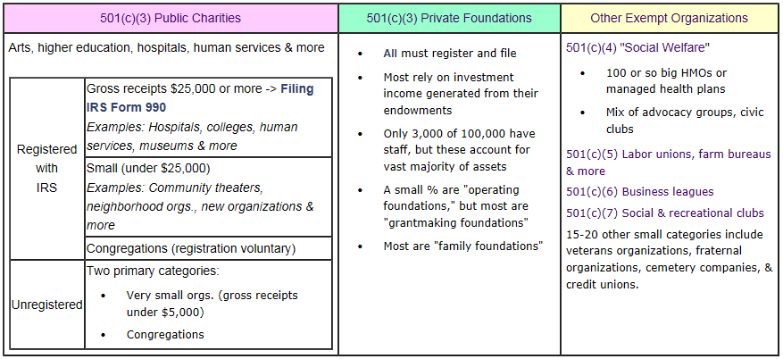
Nonprofit/Tax-Exempt Organizations
*Graph from the Nat’l Center for Charitable Statistics website: nccsweb.urban.org
Notes:
Julie

Slide 6
How big are we?
1,429,801 tax-exempt organizations, including:
  966,599 public charities
  96,584 private foundations
  366,618 other types of nonprofit organizations, including chambers of commerce, fraternal organizations and civic leagues.
    (Source: NCCS Business Master File 6/2014)
In 2010, nonprofits accounted for 9.2% of all wages and salaries paid in the United States. (Source: The Nonprofit Almanac, 2012)
Nonprofit Share of GDP was 5.5% in 2012. (Source: The Nonprofit Almanac, 2012)
Notes:
Julie

Slide 7
How big are we?
In 2012, public charities reported over $1.65 trillion in total revenues and $1.57 trillion in total expenses. Of the revenue:
  21% came from contributions, gifts and government grants.
  73% came from program service revenues, which include government fees and contracts.
  6% came from "other" sources including dues, rental income, special event income, and gains or losses from goods sold.
      (Source: NCCS Core Files 2012
Notes:
Julie

Slide 8
Growth Spurt!
Operating Public Charities – 501 c 3’s with $25K or more in revenue
2003:
  260,537 - 19.0% (of all nonprofits)
2013:
  576,757 - 40.6%
Percentage Change:
  121.4%
Notes:
Julie

Slide 9
Washington Nonprofits
16,934 ACTIVE PUBLIC CHARITIES
1 FOR EVERY 397 PEOPLE
Notes:
Julie

Slide 10
Washington Nonprofits
% Revenue by Type
$32.5 Billion
Notes:
Julie

Slide 11
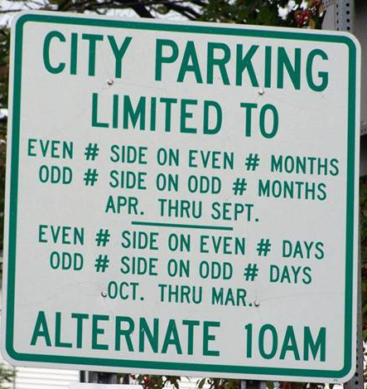
Governance: So many rules!!
Policies are many, Principles are few, Policies will change, Principles never do.
-John C. Maxwell
Notes:
Julie

Slide 12
Governance
State and Federal Government
Notes:
Julie

Slide 13

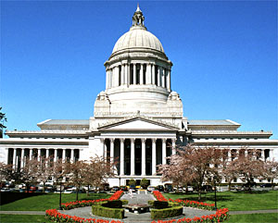
Governance
WA Secretary of State
Articles
IRS
Initial Bylaws
Notes:
Annual renewal with secretary of state

Slide 14
Governance
State and Federal Government
Articles / Bylaws
Notes:
Julie

Slide 15
Articles of Incorporation – WHO ARE YOU?
Filed at inception with Washington’s Secretary of State – establishes a Nonprofit Corporation
Specifies:
  Name
  Address
  Purpose / Mission Statement
  Initial board members
  Membership
  Personal liability
  Dissolution

Slide 16
Bylaws – HOW ARE YOU GOING TO RUN THINGS?
Filed at inception and submitted to IRS to obtain 501c3 status
Specifies:
  Size of the board and how it will function
  Roles and duties of directors and officers
  Rules and procedures for holding meetings, electing directors, and appointing officers
  Board committees
  Conflict of interest policies and procedures
State nonprofit laws usually address nonprofit governance matters. However, you can choose different rules, as long as they don’t violate state law and are included in your bylaws.

Slide 17
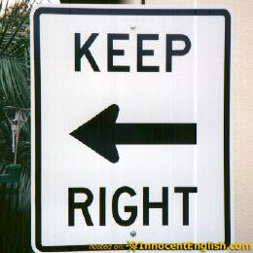
Governance
Do Articles and Bylaws matter to me? YES!
  Read them every now and again
  Check for compliance:
    Do you need to consider updating your bylaws?
    Is your board committee working within or outside its bounds?
    Are you engaging your membership accordingly?

Slide 18
Pop Quiz!
What document specifies what constitutes a quorum?
What form do you need to file with the Secretary of State annually?
What form do you need to file with the IRS annually?
Notes:
Julie
Annual report
990 or 990 EZ
Form 990-EZ is a two-page return that a nonprofits may file if its gross receipts for a tax year were <$200,000 and assets were <$500,000.
Form 990 is the "long form" that all other 990 filers must file if their gross receipts were =$200,000 or assets =$500,000.

Slide 19
Governance & Management
Staff
State and Federal Government
Articles / Bylaws
Board
Notes:
Julie

Slide 20


Board / Staff
“and”
“versus”
Notes:
Julie

Slide 21
Board and Staff
BOARD
STAFF
Governance & Fundraising
  Adherence to articles, bylaws; creation of policies
  Financial Oversight
  Advocacy
  Stakeholder representation
  Oversight of Ex. Dir.
  Strategic Planning
Operations & Fundraising
  Management
  Budgeting / Accounting
  Personnel
  Programs
  Evaluation
  Strategic Planning
Notes:
Julie

Slide 22
Governance & Management
Staff
State and Federal Government
Articles / Bylaws
Operations
Manual
Employee Handbook
Policies & Procedures
Strategic Plan
Board
Notes:
Julie

Slide 23
Legal Responsibilities of Board
The Three D’s
Duty of care: Actively participate in organizational planning and decision-making and to make sound and informed judgments.
Duty of loyalty: When acting on behalf of the organization, board members must put the interests of the nonprofit before any personal or professional concerns and avoid potential conflicts of interest.
Duty of obedience: Board members must ensure that the organization complies with all applicable federal, state, and local laws and regulations, and that it remains committed to its established mission.
Fiduciary Responsibility
Board members must evaluate financial policies, approve annual budgets, and review periodic financial reports to ensure that the organization has the necessary resources to carry out its mission and remains accountable to its donors and the general public.
Notes:
Julie

Slide 24
Organizational Structure
Board of Directors
Nominating Com.
Exec Com.
Executive Director
Finance Com.
Mktg Com.
Prgms Com.
Dev Com.
Operations
Marketing
Programs
Development
Notes:
Joe

Slide 25
Working with Committees
Extent of Committee’s authority should be specified in bylaws
Ex. Dir. may or may not be on committee with staff members
Take advantage of committee members’ expertise
When you find you have more experience, take advantage of their advocacy and stakeholder representation roles
  Committee are often vehicles for recruiting new board members. Committee members should feel valued.

Slide 26
Mission Creep
Causes:
  Chasing the money!
  Excitable board
  Excitable staff
Dangers:
  Staff burnout
  Donor/constituent confusion
  Loss of organizational integrity
Using Governance to Define Operations!!

Slide 27

Nonprofit Lifecycle

Slide 28
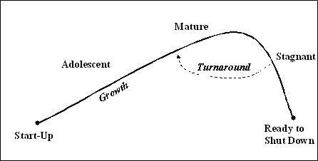
Nonprofit Lifecycle
Judith Sharken Simon, 2002 – “The 5 Life Stages of Nonproifts”

Slide 29
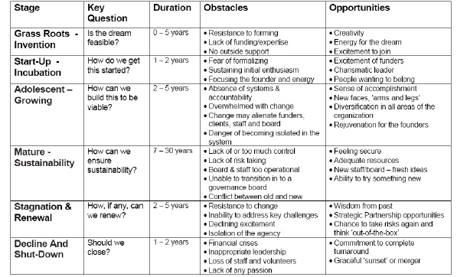
Nonprofit Lifecycle

Slide 30

Strategic Planning & Evaluation

Slide 31
Nonprofit Lifecycle
Judith Sharken Simon, 2002 – “The 5 Life Stages of Nonproifts”

Slide 32
Strategic Planning & Evaluation
Update your strategic plan every 3 – 5 years:
  Revisit Mission/Vision
  Define internal/external opportunities and threats
  Include well defined goals with timelines and project owners
  Include evaluation methods and benchmarks for programs
USE the plan! They can be wonderful management tools that keep your organization from stagnating.

Slide 33
Strategic Planning & Evaluation
Strategic Planning Resources:
http://www.councilofnonprofits.org/strategic-business-planning-for-nonprofits
Evaluation Resources:
http://www.councilofnonprofits.org/resources/resources-topic/evaluation-and-measurement
https://nonprofitquarterly.org/management/22549-using-outcomes-to-measure-nonprofit-success.html

Slide 34


Nonprofit Finances

Slide 35
Nonprofit Finances
Stanford Social Innovation Review:
“Running a nonprofit is generally more complicated than running a comparable size for-profit business.”
“When a for-profit business finds a way to create value for a customer, it has generally found its source of revenue; the customer pays for the value. With rare exceptions, that is not true in the nonprofit sector. When a nonprofit finds a way to create value for a beneficiary (for example, integrating a prisoner back into society or saving an endangered species), it has not identified its economic engine. That is a separate step.”
Our beneficiaries are our cost-drivers!

Slide 36
Nonprofit Finances
Same basic financial statements as for-profits:
  Balance Sheet (Statement of Financial Position)
  Income Statement (Statement of Activities)
  Cash Flow
Oddities
  Unrestricted, temporarily restricted and permanently restricted assets
  In-kind contributions, pledges
  Special Events and Membership Dues (know what portion is tax-deductible!)

Slide 37
Nonprofit Finances
How do funders use financial statements to evaluate health of a nonprofit:
                Cash reserves, operating deficits, debt
                Ratio of earned vs. contributed income
                “Overhead Ratio” – Under major scrutiny right now!

Slide 38

Nonprofit Finances
Endowments
  Permanently restricted capital
  Interest income is only spendable cash
  Is it what you need most?
Managing Grant Money
  This is a restricted asset
  Must track spending of grant money very carefully!
  Nonprofits have been sued for misuse of grant funding

Slide 39

Nonprofit Finances
What if a nonprofit makes a profit?

Slide 40
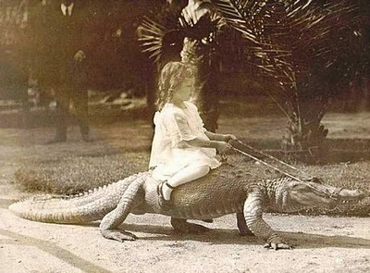
Risk Management

Slide 41
Risk Management
Reducing the likelihood or severity of some unknown occurrence that could prevent or seriously derail a nonprofit from fulfilling its mission.
  Hiring – checking references
  Financial – establishing cash reserves, separation of duties (watch out for the “trusted employee!”)
  Data – backing up
  Accidents – ensuring a safe work environment
  Governance – ensure board members are fully trained

Slide 42
Risk Management
Written Policy Statements that aid in Risk Management:
Confidentiality Agreement
Conflict of Interest
Document Retention and Destruction
Executive Compensation
Gift Acceptance
Joint Venture and Partnership
Media Spokesperson
Whistleblower Protection
http://www.councilofnonprofits.org/resources/resources-topic/risk-management-and-insurance#sthash.QBgvm9JR.dpuf

Slide 43


